Slide 1

Upskill INDIA Jan-2023
ANALYTICAL REASONING STREAM – SESSION4
To attend the sessions, you need to register using the link:
https://www.openmentor.net/upskill-jan-2023-program#enrollment

Slide 2
Pattern Matching
Visual reasoning – graphical representation of the problem and finding a solution for the same.
Courtesy: www.intelligencetest.com

Slide 3
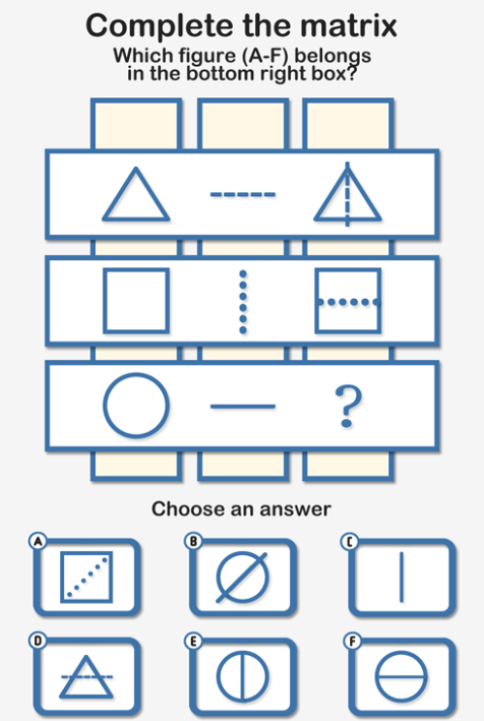
Hint 1:
The left column remains unchanged in the third column of each row.
Hint 2:
The left column remains unchanged in the third column of each row.
Answer is E

Slide 4
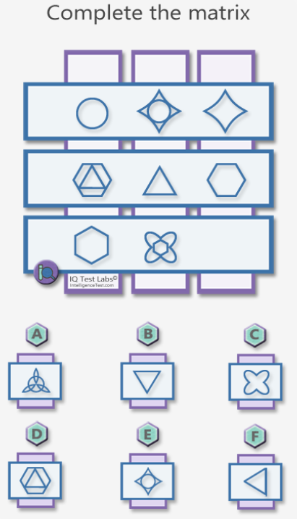
Hint 1:
For each column, there are two main shapes.
Answer is
C

Slide 5
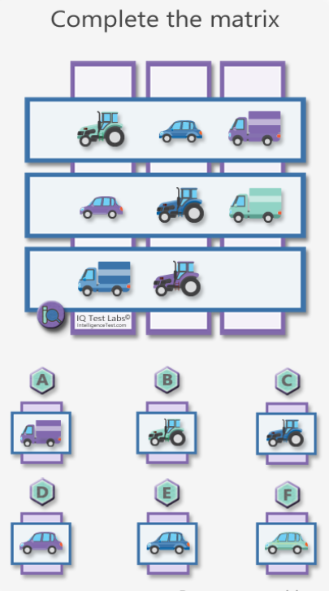
Hint 1:
There should be three of each vehicle.
Answer is F

Slide 6
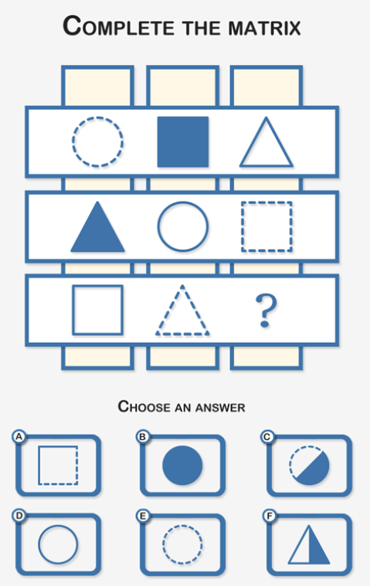
Hint 1:
There are three basic shapes, circles, squares and triangles.
Hint 2:
Each basic shape is either straight line, dashed line or solid.
Answer is B

Slide 7
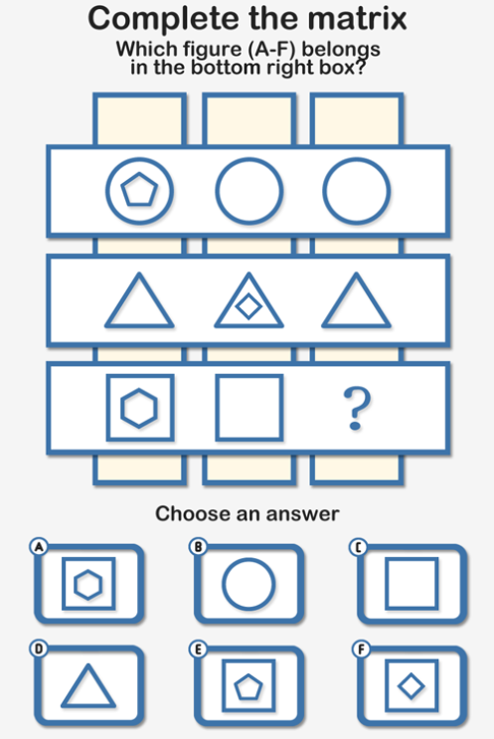
Hint 1:
Search for a common theme.
Hint 2:
Notice shapes that appear consistently in each row.
Answer is C

Slide 8
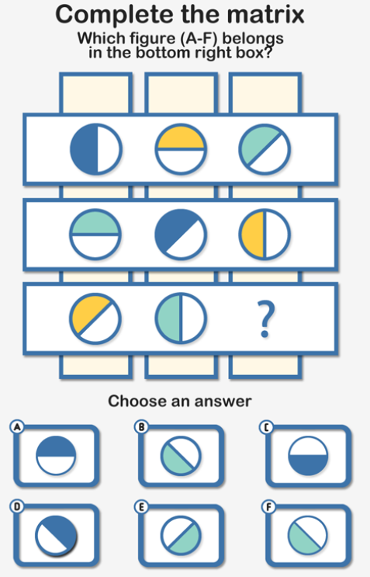
Hint 1:
There are three different degrees of rotation.
Hint 2:
There are three sets of three colors.
Answer is C!!
The correct Answer is A

Slide 9
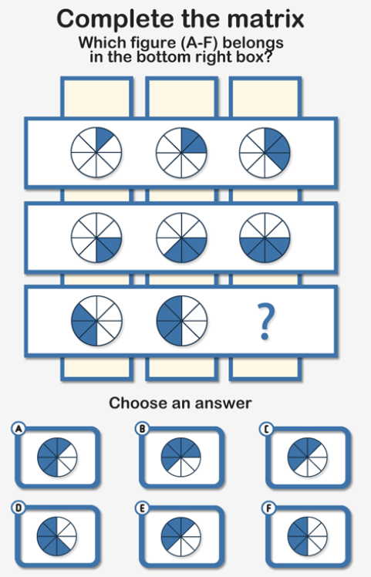
Hint 1:
The number of segments increases from left to right in each row, and from top to bottom in each column.
Hint 2:
The position of the segments/wedges is determined by the rows and not by the columns.
Answer is A

Slide 10
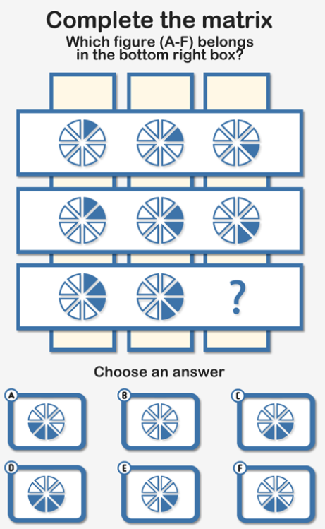
Hint 1:
The question can be solved both by row by row
and column by column.
Hint 2:
Depending on the row vs. column perspective, the defining
rule changes.
Answer is C

Slide 11
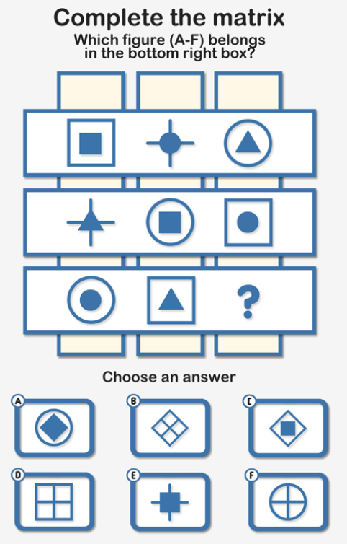
Hint 1:
Place shapes into two sets.
Hint 2:
One of the sets is comprised of the solid square, circle and triangle.
Answer is E

Slide 12
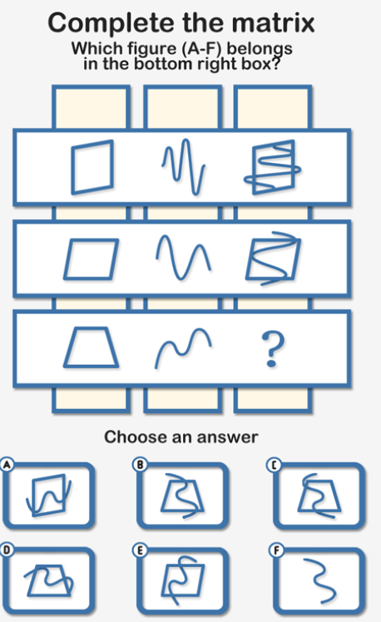
Hint 1:
One of the rules is rotation.
Hint 2:
Notice shapes that appear consistently in each row.
Answer is B

Slide 13
Find the Hidden Objects in the picture
This helps in focusing on the details of what is given to us
https://docs.google.com/forms/d/e/1FAIpQLScRLZ5CKDDUyshNzJEQdItyD1C7bRZ67pCmt5cJOxRnRWtB7g/viewform?usp=sf_link

Slide 14
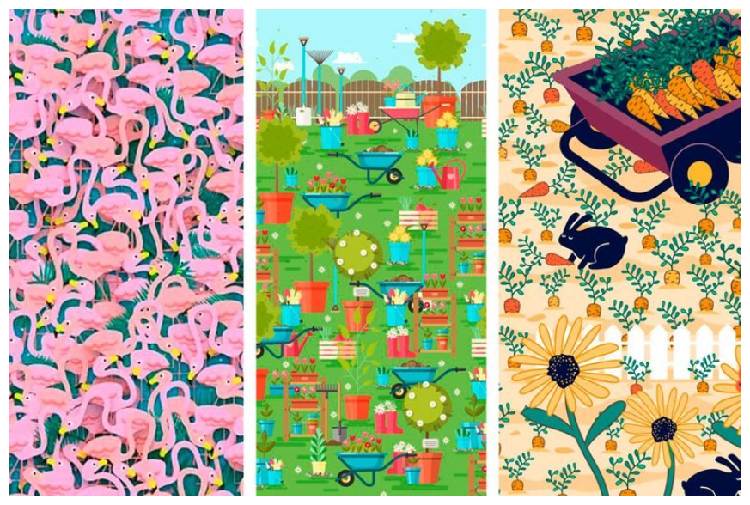
Poll 1 Poll 2 Poll 3
Courtesy: Readers Digest

Slide 15
Recordings of the sessions
Videos will be available in the following link
learn.openmentor.net

